Slide 1
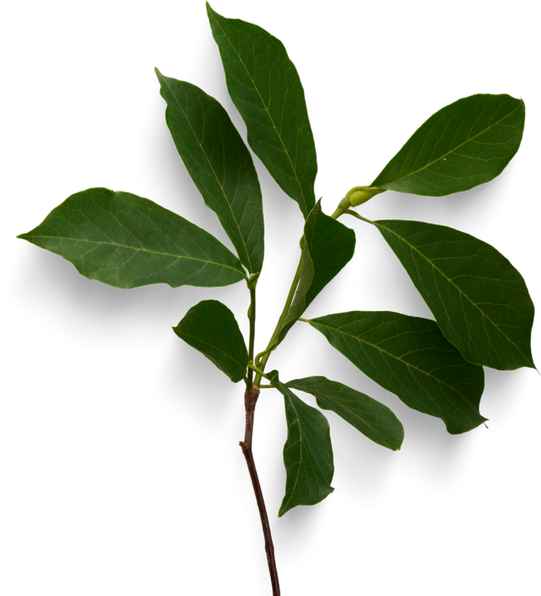
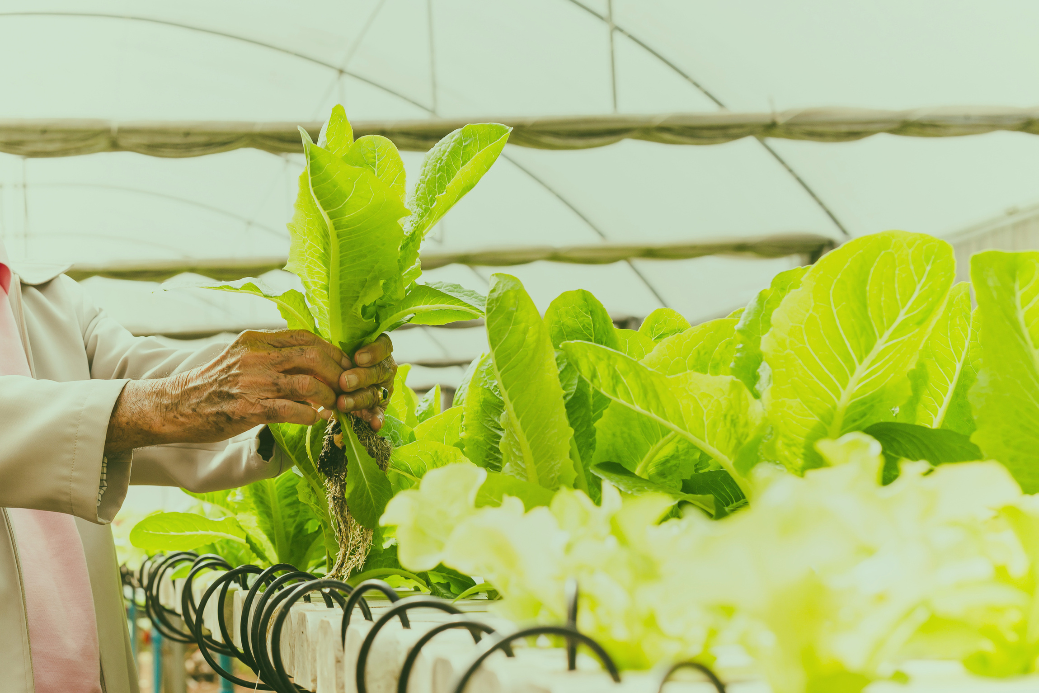



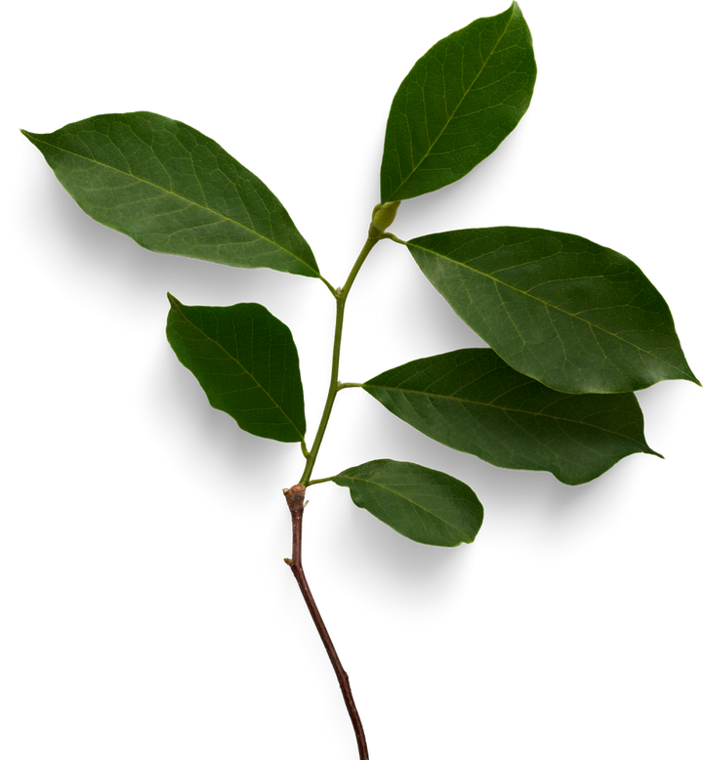
AGRICULTURE IN EGYPT

Slide 2

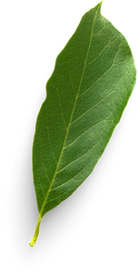
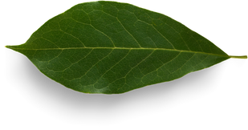
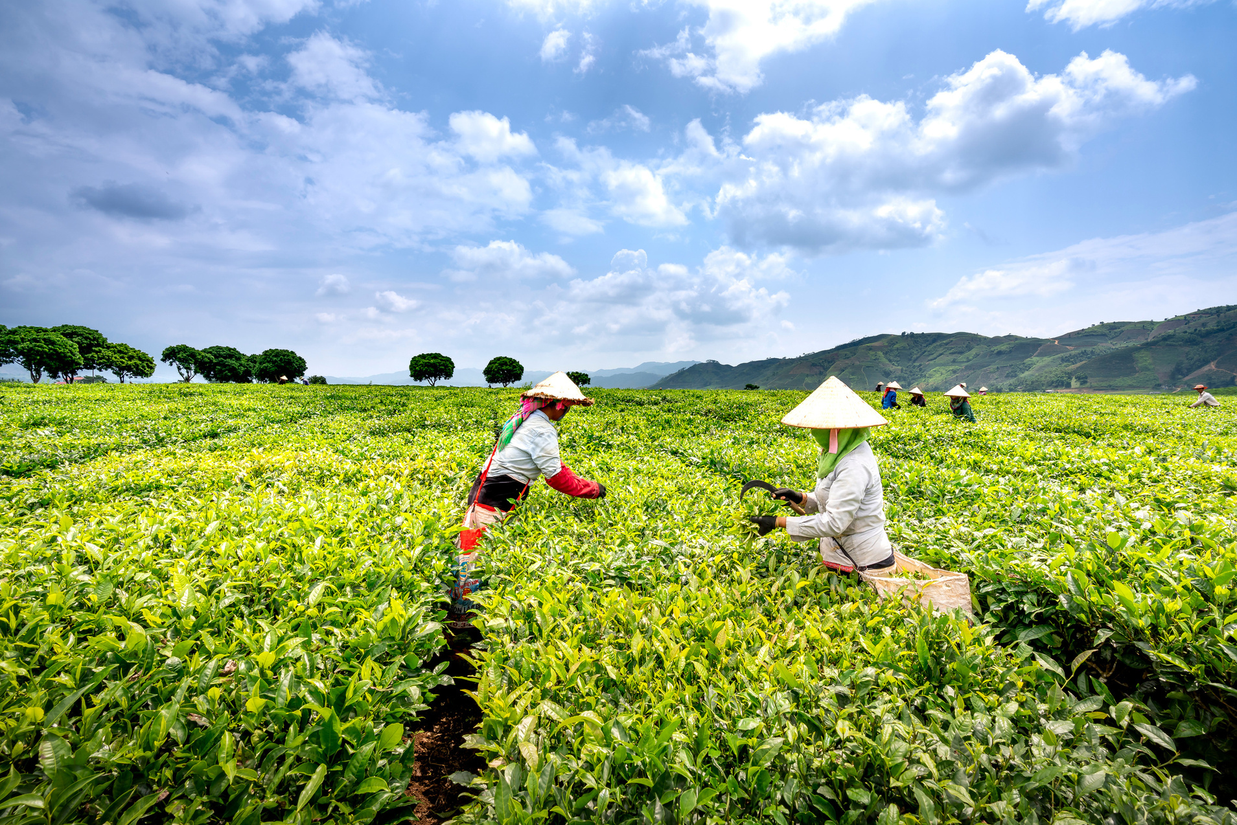
Agriculture in Egypt
PROBLEM DEFINATION
HIGH CROP LOSSES: PLANT DISEASES REDUCE PRODUCTIVITY AND QUALITY, CAUSING MAJOR ECONOMIC DAMAGE FOR FARMERS.
HARD TO DETECT EARLY: MANY INFECTIONS START WITH SUBTLE SYMPTOMS THAT FARMERS MISS UNTIL THE DISEASE HAS SPREAD WIDELY.
LACK OF EXPERT DIAGNOSIS: MANY FARMERS DON'T HAVE ACCESS TO SPECIALISTS, LEADING TO MISDIAGNOSIS AND WRONG TREATMENT.

Slide 3
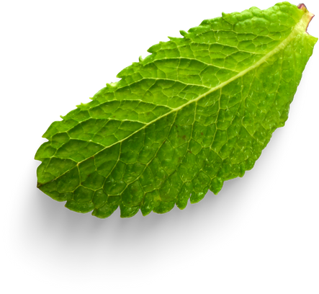
AI ROLE
Large-Scale Monitoring
Early & Accurate Detection
AI can process data from:
Smart cameras
Drones
IoT sensors
to monitor entire farms in real-time.
AI models analyze leaf images to identify diseases before symptoms become severe, reducing crop losses.
Faster Decision-Making
Automated Diagnosis
AI systems provide instant recommendations:
Spray or not?
Which treatment?
How urgent is the infection?
Computer vision can detect disease type, severity, and affected plant parts — without needing a human expert.

Slide 4

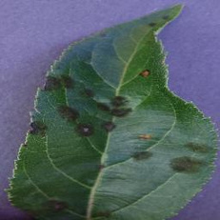
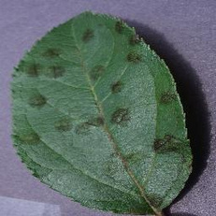
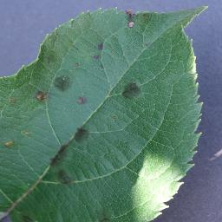

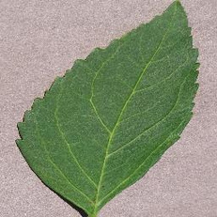
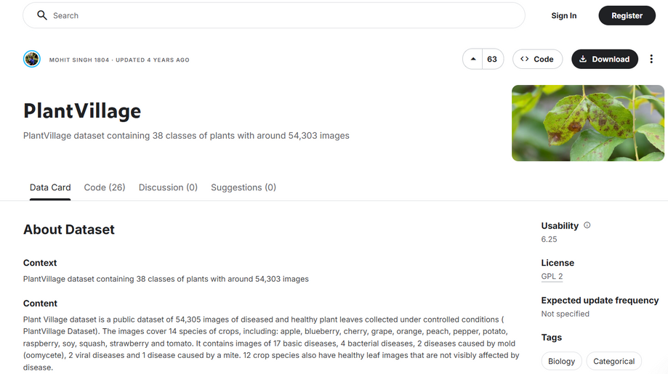
Agriculture in Egypt
OUR
DATA SET
https://github.com/digitalepidemiologylab/plantvillage_deeplearning_paper_dataset
The system uses the *PlantVillage Dataset*, which includes:
* 50,000+ labeled images
* Multiple plant types
* Around 38 disease categories including healthy leaves

Slide 5
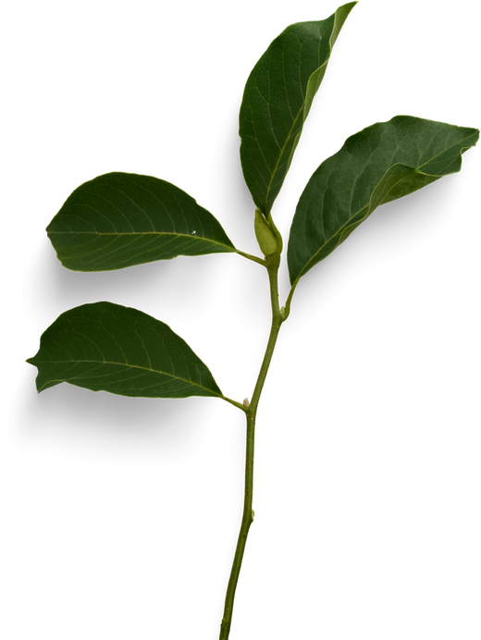

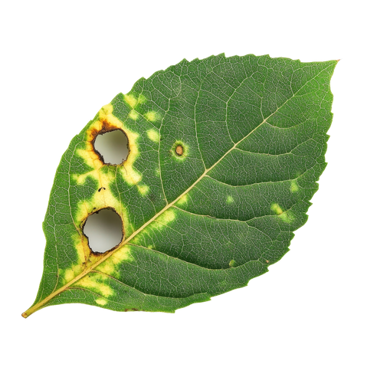

PROCESS
Agriculture in Egypt
INPUT
OUTPUT
🧠 AI PREDICTION RESULT
TOMATO LATE BLIGHT
📊 CONFIDENCE
97.4%
✅ RECOMMENDATION
✔ REMOVE INFECTED LEAVES IMMEDIATELY
✔ APPLY COPPER-BASED FUNGICIDE
✔ AVOID WATERING LEAVES DIRECTLY

Slide 6

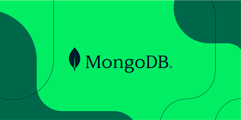


Agriculture in Egypt
Tech Stack
MongoDB: fast, flexible NoSQL database.
Next.js: frontend + backend in one, SSR.
Python + Keras: build AI model.
Hugging Face: deploy model as an API.

Slide 7

Agriculture in Egypt
JOURNEY
week 1
week 2
week 3
week 4
Integration & Completion
Integration & Completion
Model Development
Model Development
Model Finalization
Model Finalization
Web Development
Web Development
* Data preprocessing and image preparation
* Building MobileNetV2 and starting training
* First evaluation and model adjustments
* Data preprocessing and image preparation
* Building MobileNetV2 and starting training
* First evaluation and model adjustments
* Fine-tuning the model
* Final testing
* Saving the model as .h5
* Deployment to HuggingFace as an inference API
* Fine-tuning the model
* Final testing
* Saving the model as .h5
* Deployment to HuggingFace as an inference API
* Setting up Next.js project
* Designing pages (Home, Upload, Result)
* Creating API routes for image submission
* Next.js backend communicates with the HuggingFace model
* Displaying prediction results in the frontend
* UI improvements and adding treatment instructions
* Preparing presentation and documentation
* Next.js backend communicates with the HuggingFace model
* Displaying prediction results in the frontend
* UI improvements and adding treatment instructions
* Preparing presentation and documentation
Notes:
6

Slide 8
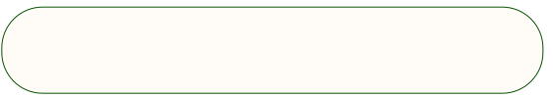
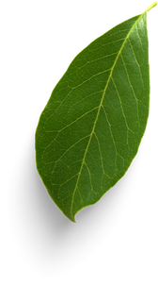
Agriculture in Egypt
OUR TEAM
Abdallah Ali khamis
Bavly Momtaz
Abdulrhman Helmy
Zeyad Mohamed

Slide 9
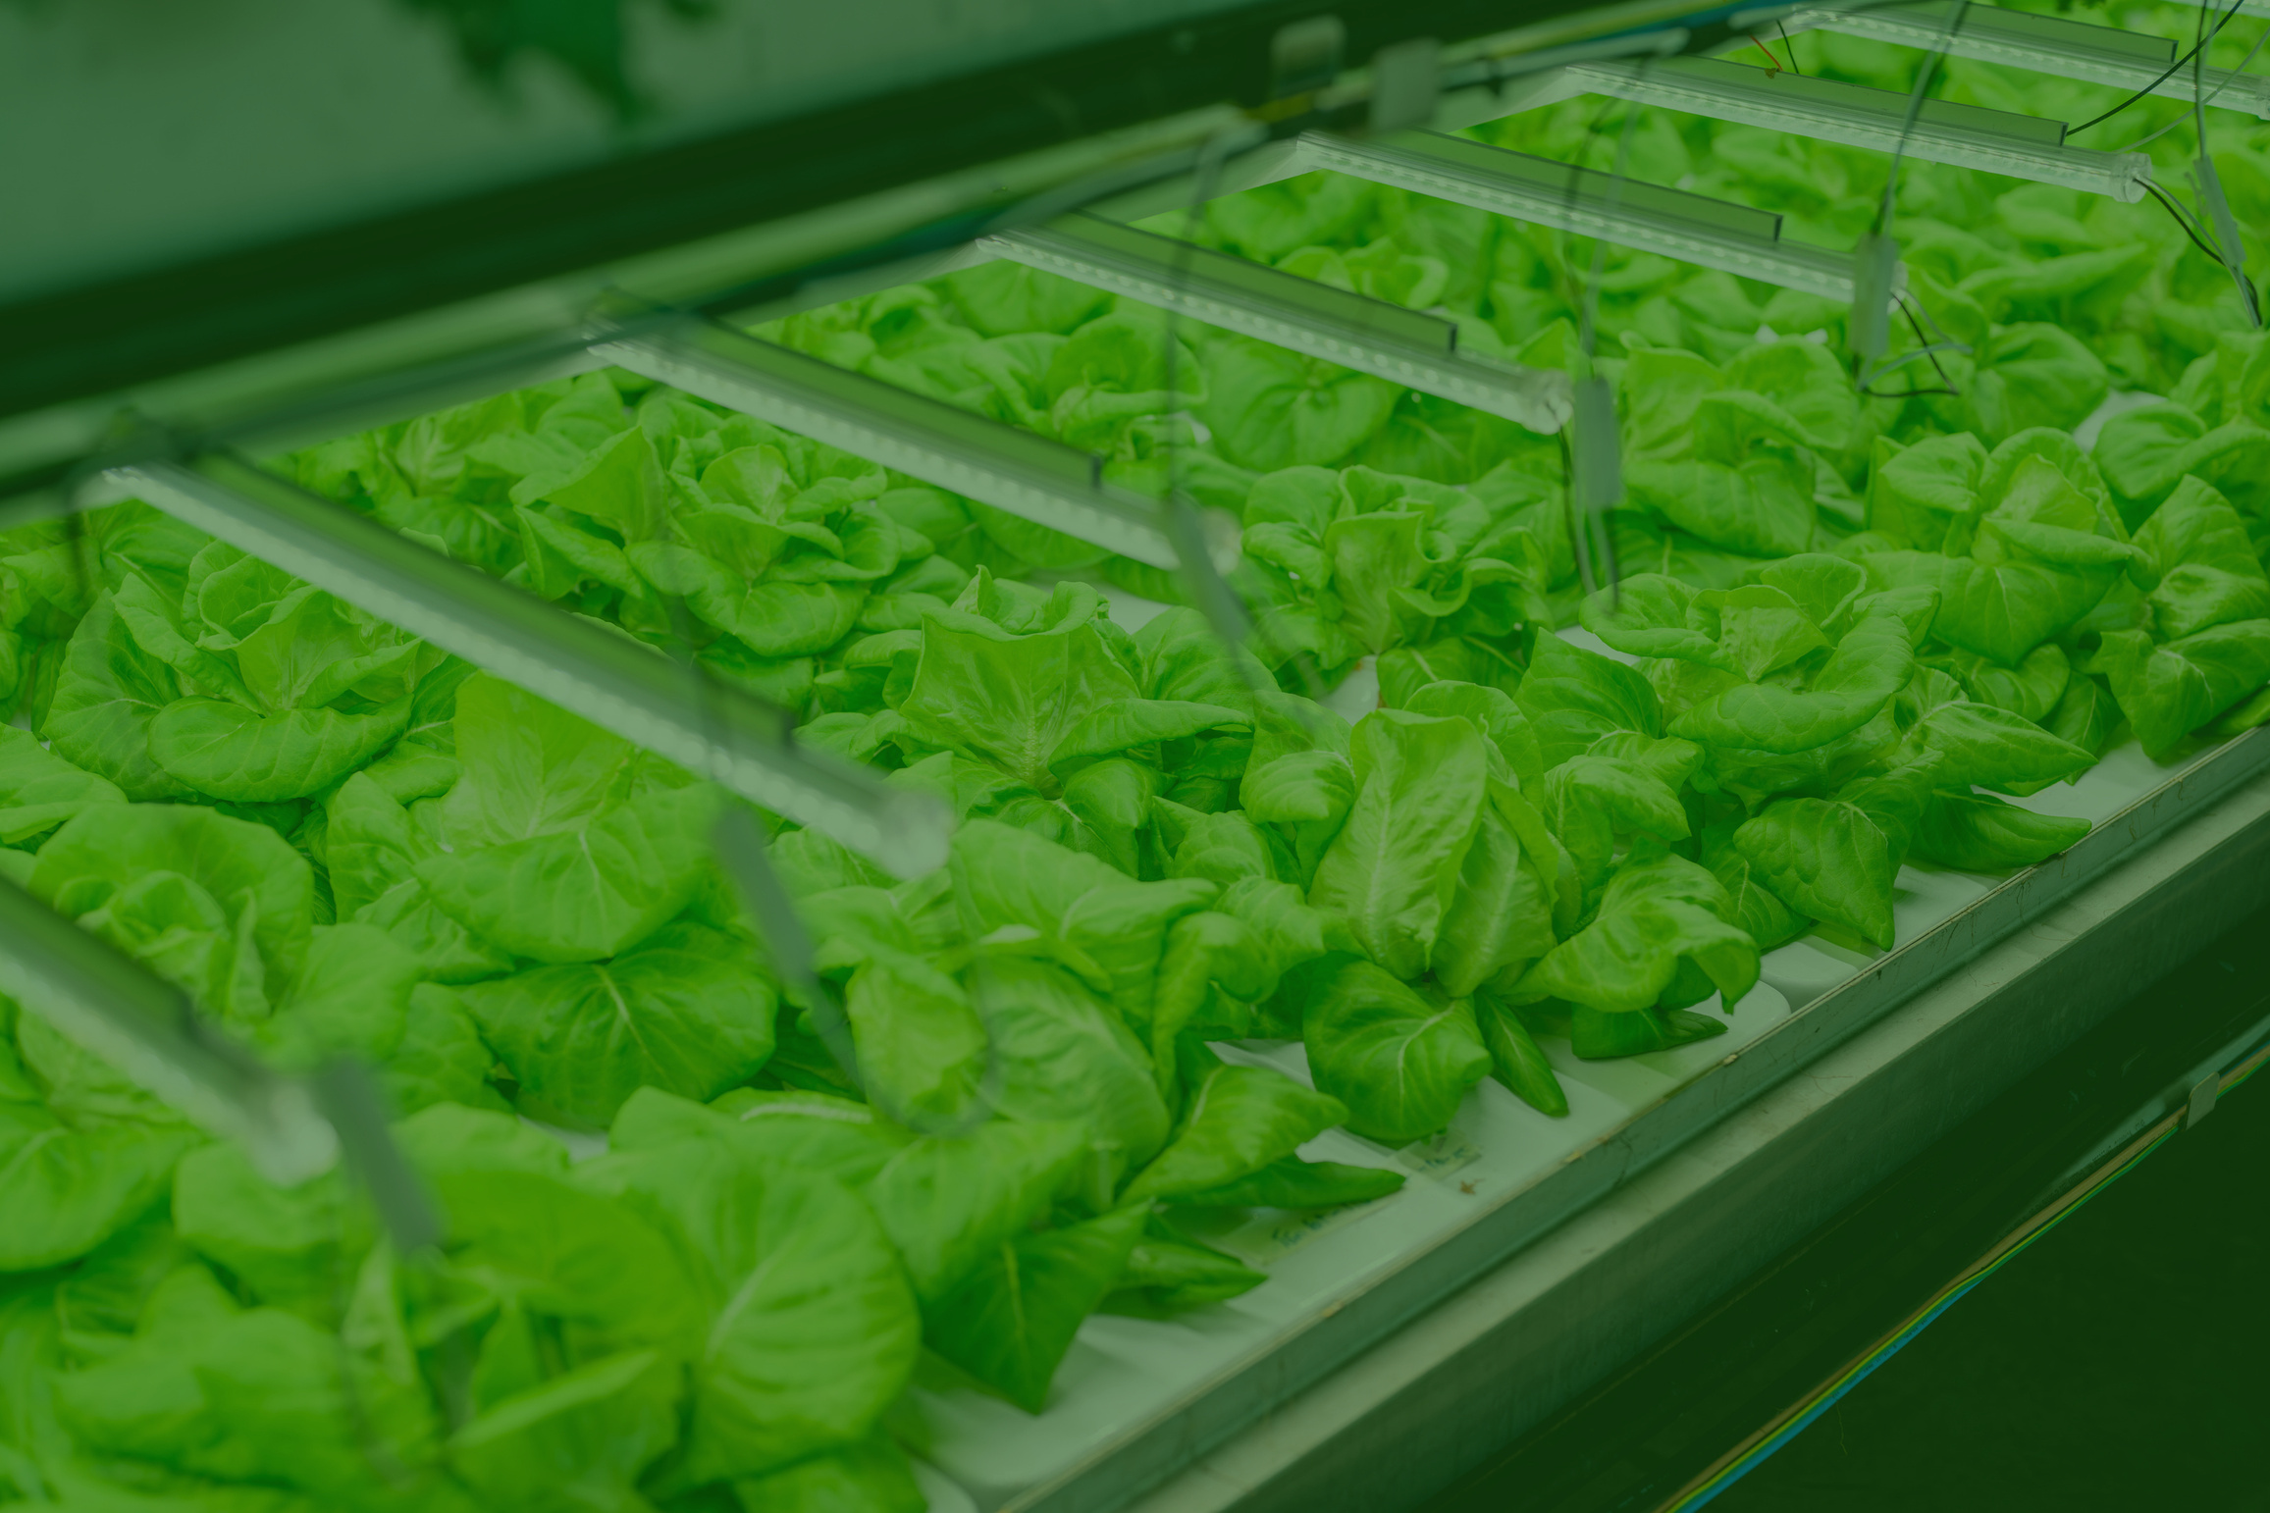
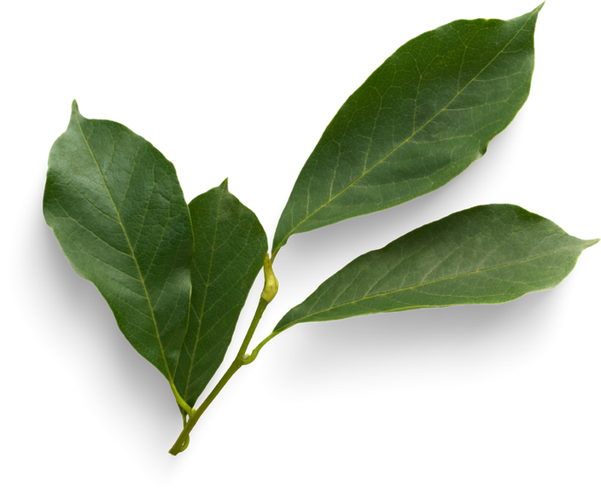
THANK YOU

